Slide 1
W4111 – Introduction to Databases Section 002, Spring 2021 Lecture 6: Finishing SQL and ER; Project Discussion
© Donald F. Ferguson, 2021

Slide 2
W4111 – Introduction to Databases Section 002, Spring 2021 Lecture 6: Finishing SQL and ER; Project Discussion
We will start in a couple of minutes.
© Donald F. Ferguson, 2021

Slide 3

Contents
3 | COMS W4111_002_2021_1: Lecture 6: SQL_ER_Final_Project © Donald F. Ferguson, 2021

Slide 4
Contents
Final SQL Concepts:
Two simple index examples.
Completing:
Functions.
Triggers.
Procedures.
Security
Some Advanced ER → Relational Mapping
Inheritance (Continued)
Composite Attributes
Multivalued attributes.
N-ary relationships, for N > 2.
Midterm walkthrough. (There will be recitations)
Some of this woven into
main presentation flow.

Slide 5
Two Simple Index Examples
5 | COMS W4111_002_2021_1: Lecture 6: SQL_ER_Final_Project © Donald F. Ferguson, 2021

Slide 6
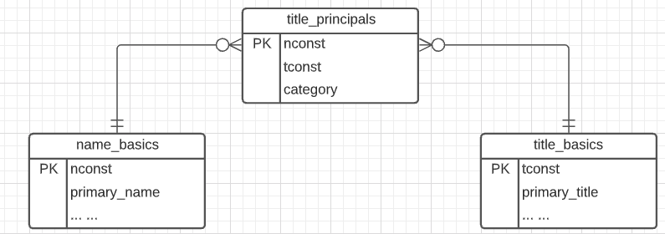
Consider a Subset of the IMDB Data Model
Three core entities:
name_basics: Core information about actors, writers, ... ... (10M rows)
title_basics: Core information about a movie, TV series, episode, ... ... (7M rows)
title_principals: Associative entity implement many-to-many relationship with properties. (42M rows)
Associative entities have foreign keys to the entities they link.
Let’s look at some queries and scenarios:
Simple lookups.
JOINs
Foreign Keys
Switch to notebook.

Slide 7
Attribute
The set of allowed values for each attribute is called the domain of the attribute
Attribute values are (normally) required to be atomic; that is, indivisible
The special value null is a member of every domain. Indicated that the value is “unknown”
The null value causes complications in the definition of many operations
DFF Comments:
Atomic and use of Null is important?
I will explain the importance of atomic attributes and null in examples.
Remember this comment from lecture 2? You will now see one reason why.

Slide 8
Complex Attributes
Attribute types:
Simple and composite attributes.
Single-valued and multivalued attributes
Example: multivalued attribute: phone_numbers
Derived attributes
Can be computed from other attributes
Example: age, given date_of_birth
Domain – the set of permitted values for each attribute

Slide 9
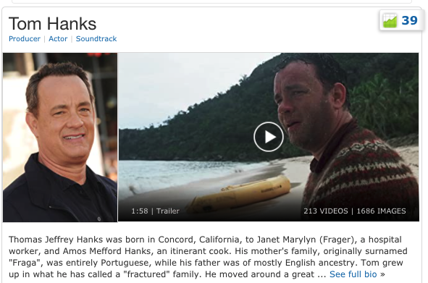
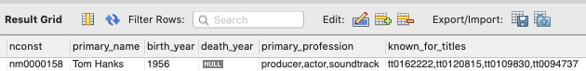
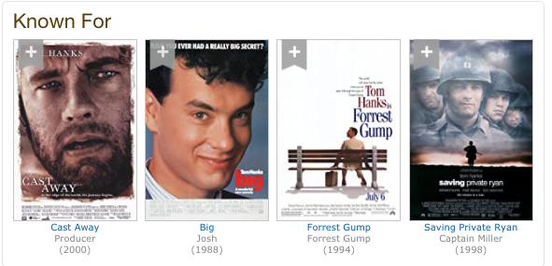
IMDB Known For
Raw data when loaded into DB is:
Known_for_titles is a multivalued attribute. It is 4 values in a set drawn from a domain.
We saw some interesting index issues for a composite attribute.
Multivalued attributes also introduce some interesting issues.
Switch to notebook.

Slide 10
Multivalued and Composite Attributes
Multivalued and composite attributes
Can result in some very strange SQL.
And are impossible to index properly.
Which results in awkward and slow queries.
Multivalued and composite attributes can also compromise integrity.
Foreign keys are an example.
I cannot define a foreign key that ensures that:
Each element in “tt0162222,tt0120815,tt0109830,tt0094737”
Has a corresponding row in in another table.
How do you handle these situations?
Decompose composite attributes into columns or a separate table.
Multi-valued attributes are a many-to-many pattern.

Slide 11
Functions, Procedures, Triggers
11 | COMS W4111_002_2021_1: Lecture 6: SQL_ER_Final_Project © Donald F. Ferguson, 2021

Slide 12

Concepts (Reminder)
12 | COMS W4111_002_2021_1: Lecture 6: SQL_ER_Final_Project © Donald F. Ferguson, 2021

Slide 13
Functions and Procedures
Functions and procedures allow “business logic” to be stored in the database and executed from SQL statements.
These can be defined either by the procedural component of SQL or by an external programming language such as Java, C, or C++.
The syntax we present here is defined by the SQL standard.
Most databases implement nonstandard versions of this syntax.
Note:
The programming language, runtime and tools for functions, procedures and triggers are not easy to use.
My view is that calling external functions is an anti-pattern (bad idea).
External code degrades the reliability, security and performance of the database.
Databases are often mission critical and the heart of environments.
We covered the language and functions in the last lecture. We will cover triggers in this lecture.

Slide 14
Triggers
14 | COMS W4111_002_2021_1: Lecture 5: Advanced SQL and Projects © Donald F. Ferguson, 2021

Slide 15
Triggers
A trigger is a statement that is executed automatically by the system as a side effect of a modification to the database.
To design a trigger mechanism, we must:
Specify the conditions under which the trigger is to be executed.
Specify the actions to be taken when the trigger executes.
Triggers introduced to SQL standard in SQL:1999, but supported even earlier using non-standard syntax by most databases.
Syntax illustrated here may not work exactly on your database system; check the system manuals

Slide 16
Triggering Events and Actions in SQL
Triggering event can be insert, delete or update
Triggers on update can be restricted to specific attributes
For example, after update of takes on grade
Values of attributes before and after an update can be referenced
referencing old row as : for deletes and updates
referencing new row as : for inserts and updates
Triggers can be activated before an event, which can serve as extra constraints. For example, convert blank grades to null.
create trigger setnull_trigger before update of takes referencing new row as nrow for each row when (nrow.grade = ' ') begin atomic set nrow.grade = null; end;

Slide 17
Trigger to Maintain credits_earned value
create trigger credits_earned after update of takes on (grade) referencing new row as nrow referencing old row as orow for each row when nrow.grade <> 'F' and nrow.grade is not null and (orow.grade = 'F' or orow.grade is null) begin atomic update student set tot_cred= tot_cred + (select credits from course where course.course_id= nrow.course_id) where student.id = nrow.id; end;

Slide 18
Statement Level Triggers
Instead of executing a separate action for each affected row, a single action can be executed for all rows affected by a transaction
Use for each statement instead of for each row
Use referencing old table or referencing new table to refer to temporary tables (called transition tables) containing the affected rows
Can be more efficient when dealing with SQL statements that update a large number of rows

Slide 19
When Not To Use Triggers
Triggers were used earlier for tasks such as
Maintaining summary data (e.g., total salary of each department)
Replicating databases by recording changes to special relations (called change or delta relations) and having a separate process that applies the changes over to a replica
There are better ways of doing these now:
Databases today provide built in materialized view facilities to maintain summary data
Databases provide built-in support for replication
Encapsulation facilities can be used instead of triggers in many cases
Define methods to update fields
Carry out actions as part of the update methods instead of through a trigger

Slide 20
When Not To Use Triggers (Cont.)
Risk of unintended execution of triggers, for example, when
Loading data from a backup copy
Replicating updates at a remote site
Trigger execution can be disabled before such actions.
Other risks with triggers:
Error leading to failure of critical transactions that set off the trigger
Cascading execution

Slide 21
Materialized Views
Certain database systems allow view relations to be physically stored.
Physical copy created when the view is defined.
Such views are called Materialized view:
If relations used in the query are updated, the materialized view result becomes out of date
Need to maintain the view, by updating the view whenever the underlying relations are updated.

Slide 22
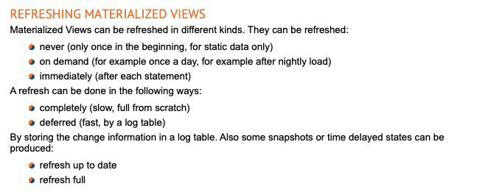
Trigger Example – Violating when not to Use
Materialized view support, especially update, is inconsistent.
We are going to use triggers to keep a materialized view (copy table) up to date.
Back to the Notebook. Write a Trigger.

Slide 23
Summary
23 | COMS W4111_002_2021_1: Lecture 5: Advanced SQL and Projects © Donald F. Ferguson, 2021

Slide 24
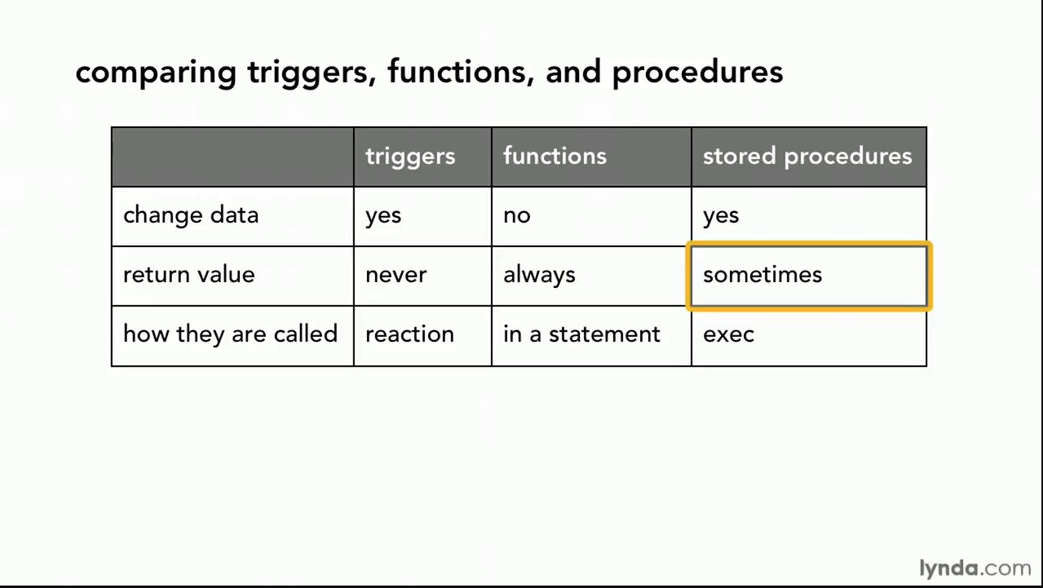
Comparison

Slide 25
Comparison – Some Details
A trigger has capabilities like a procedure, except ...
You do not call it. The DB engine calls it before or after an INSERT, UPDATE, DELETE.
The inputs are the list of incoming new, modified rows.
The outputs are the modified versions of the new or modified rows.

Slide 26
Complex Examples Columbia Courses, Sections, Enrollments (Part II – Students and Faculty)
26 | COMS W4111_002_2021_1: Lecture 5: Advanced SQL and Projects © Donald F. Ferguson, 2021

Slide 27
IsA, Inheritance, Generalization, Specialization
27 | COMS W4111_002_2021_1: Lecture 5: Advanced SQL and Projects © Donald F. Ferguson, 2021

Slide 28
Faculty and Students
ER Notation
We modelled course.
To enroll students in courses, we need ...
Sections
Faculty
Students
Let’s focus on the “people aspect.” We have
People
A Faculty is a People.
A Student is a People.
“In object-oriented programming, inheritance is the mechanism of basing an object or class upon another object (prototype-based inheritance) or class (class-based inheritance), retaining similar implementation. Also defined as deriving new classes (sub classes) from existing ones such as super class or base class and then forming them into a hierarchy of classes.”
This is a new type of relationship in ER modeling.

Slide 29
Specialization
Top-down design process; we designate sub-groupings within an entity set that are distinctive from other entities in the set.
These sub-groupings become lower-level entity sets that have attributes or participate in relationships that do not apply to the higher-level entity set.
Depicted by a triangle component labeled ISA (e.g., instructor “is a” person).
Attribute inheritance – a lower-level entity set inherits all the attributes and relationship participation of the higher-level entity set to which it is linked.

Slide 30
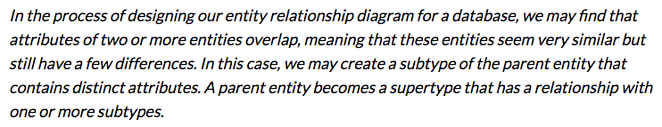
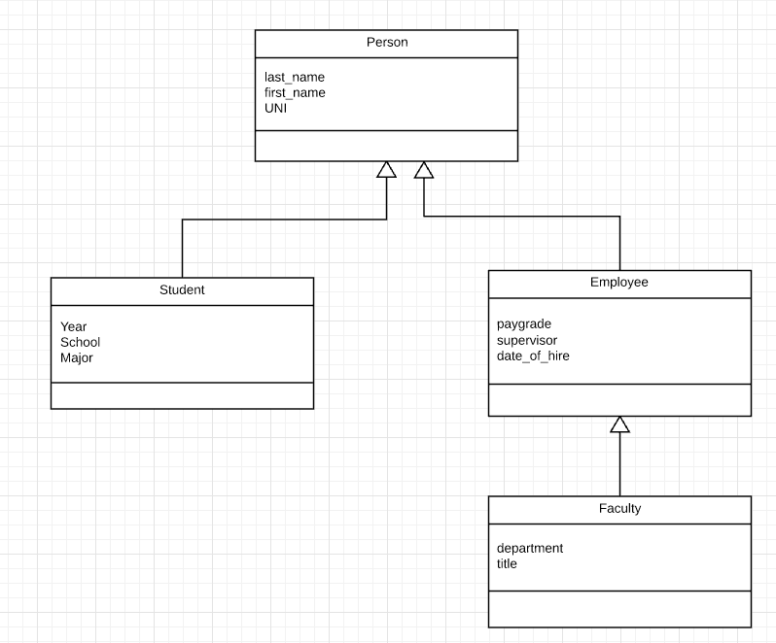
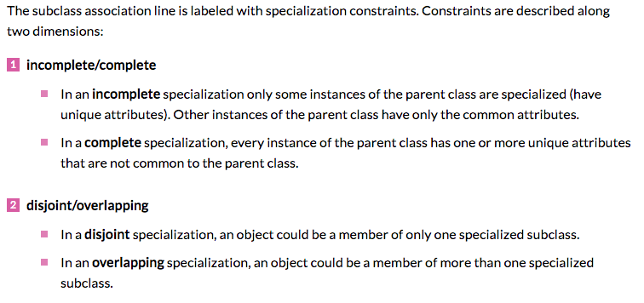
Inheritance, IsA, Specialization
Are all employees faculty?
Can students also be employees?
http://www.vertabelo.com/blog/technical-articles/inheritance-in-a-relational-database
30 | W4111_02_F20: Introduction to Databases – Lecture 6

Slide 31
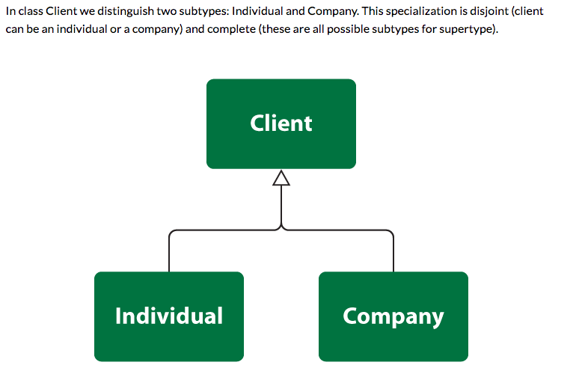
Simpler Example
31 | W4111_02_F20: Introduction to Databases – Lecture 6

Slide 32
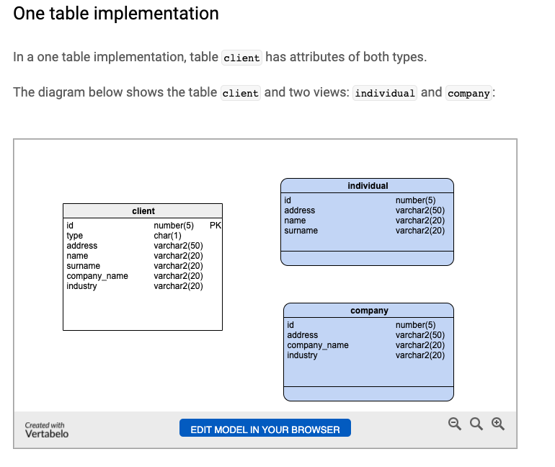
One Table Implementation
Views
Tables
32 | W4111_02_F20: Introduction to Databases – Lecture 6

Slide 33
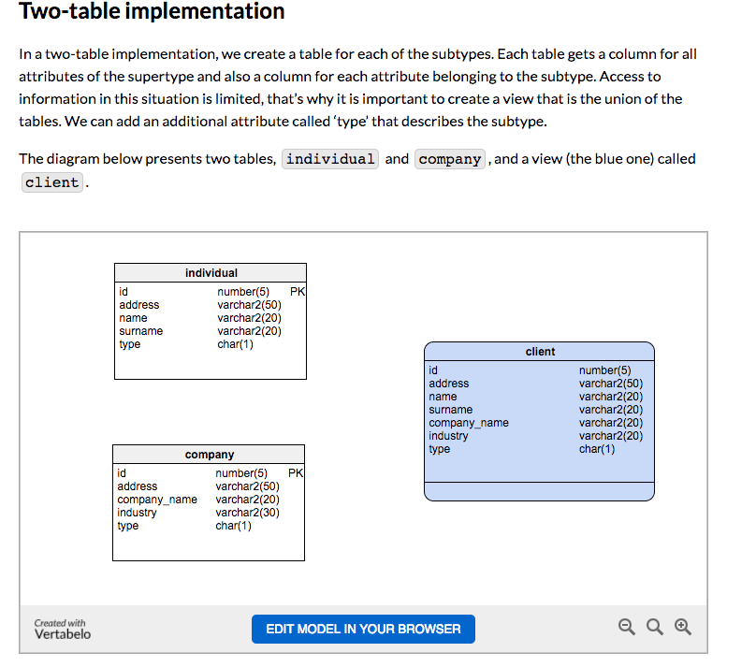
Two Table Implementation
View
Tables
33 | W4111_02_F20: Introduction to Databases – Lecture 6

Slide 34
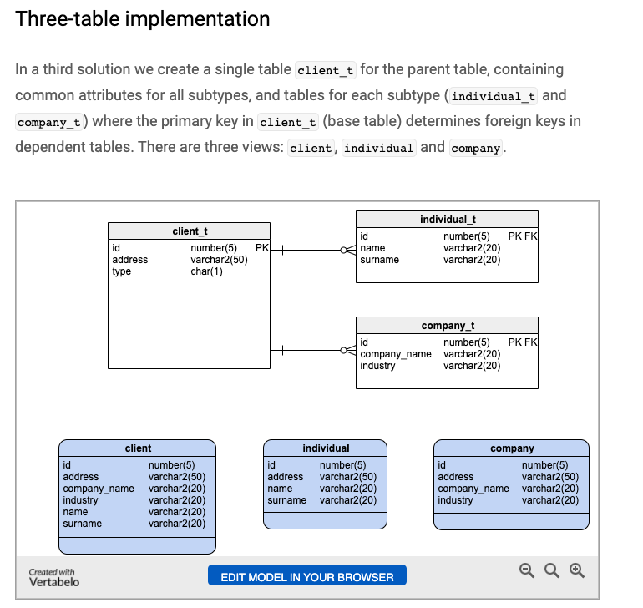
Two Table Implementation
Tables
Views
34 | W4111_02_F20: Introduction to Databases – Lecture 6

Slide 35
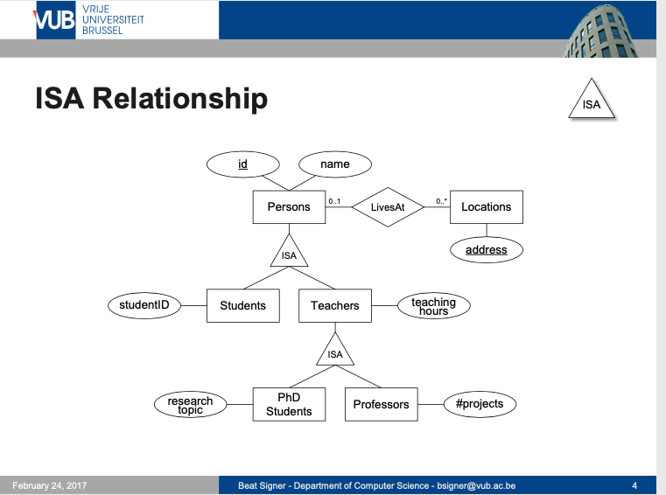
Modeling
35 | W4111_02_F20: Introduction to Databases – Lecture 6

Slide 36
ER vs. UML Class Diagrams
ER Diagram Notation
Equivalent in UML
I use this approach in Crow’s Foot Notation but that is not standard.
* Generalization can use merged or separate arrows independent
of disjoint/overlapping

Slide 37
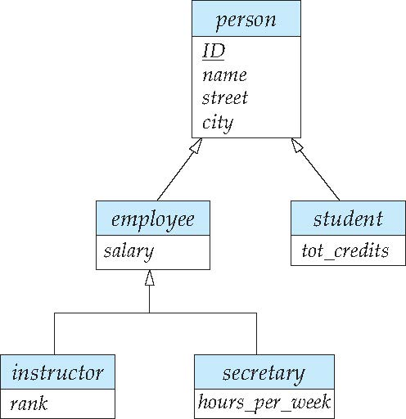
Specialization Example
Overlapping – employee and student
Disjoint – instructor and secretary
Total and partial

Slide 38
Generalization
A bottom-up design process – combine a number of entity sets that share the same features into a higher-level entity set.
Specialization and generalization are simple inversions of each other; they are represented in an E-R diagram in the same way.
The terms specialization and generalization are used interchangeably.

Slide 39
Completeness constraint
Completeness constraint -- specifies whether or not an entity in the higher-level entity set must belong to at least one of the lower-level entity sets within a generalization.
total: an entity must belong to one of the lower-level entity sets
partial: an entity need not belong to one of the lower-level entity sets

Slide 40
Completeness constraint (Cont.)
Partial generalization is the default.
We can specify total generalization in an ER diagram by adding the keyword total in the diagram and drawing a dashed line from the keyword to the corresponding hollow arrow-head to which it applies (for a total generalization), or to the set of hollow arrow-heads to which it applies (for an overlapping generalization).
The student generalization is total: All student entities must be either graduate or undergraduate. Because the higher-level entity set arrived at through generalization is generally composed of only those entities in the lower-level entity sets, the completeness constraint for a generalized higher-level entity set is usually total

Slide 41
Worked Example
41 | COMS W4111_002_2021_1: Lecture 5: Advanced SQL and Projects © Donald F. Ferguson, 2021

Slide 42
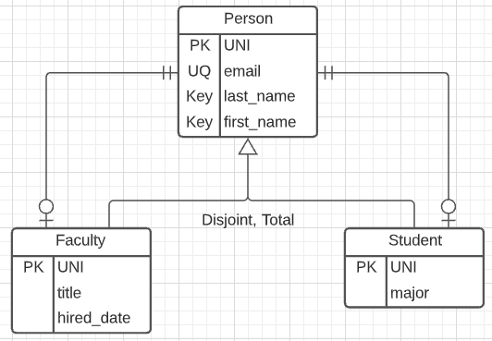
Person, Faculty, Student
Model
Complete:
Every entity is a Faculty or a Student.
There are no entities that are just Person.
Disjoint:
Either a Faculty or a Student
But not both.
3-Table solution.
Relationships:
Faculty-Person is one-to-one.
Student-Person is one-on-one.
Person is exactly 1.
Faculty or Student is 0-1.
There is no easy way to handle the fact that one of Faculty or Student must exist.

Slide 43
The UNI
The UNI creates some interesting challenges:
A given UNI is in two tables: Person, Faculty or Person, Student.
A given UNI can only be in the Faculty table or the Student table.
My algorithm for generating the UNI is:
Prefix: Concatenate
First two characters of first name.
First two characters of the last name
Suffix: Add 1 to the number of existing UNIs with the same prefix.
Concatenate the prefix and suffix.
Immutable: Cannot change.
Implementing the semantics in applications accessing the data is error prone.
The more places you implement something, the more places you can mess up.
You have to find all the apps and change them if the logic changes.
So, we are going to implement using a function and trigger.

Slide 44
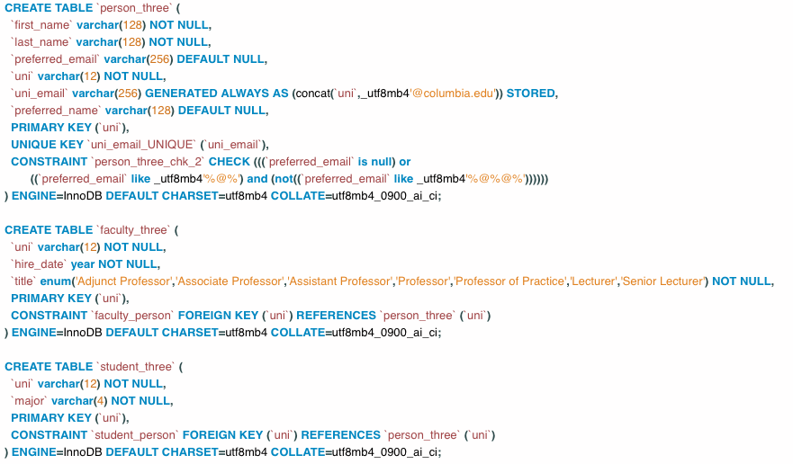
Table Definitions

Slide 45
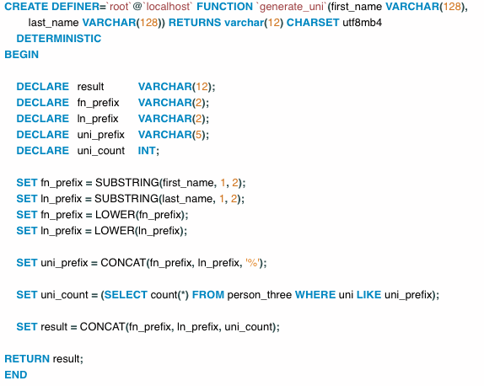
Function
Switch to notebook.

Slide 46
Design Pattern for Inheritance Integrity
So far, we have created:
A three-table solution to a simple inheritance design problem.
Core elements are:
Function for computing UNIs.
A view to query the concrete class without exposing inheritance.
A procedure to create one of the concrete classes and the base classes.
But,
We would still need to implement the update and delete stored procedures to ensure encapsulation and integrity. This prevents users from corrupting the data by removing the need to understand the model and write SQL scripts.
Implement a Trigger that rejects changing the UNI. Let’s do that now.
But, what if someone mistakenly uses the tables directly with SQL statements. That would still cause integrity problems.
We can use identity, roles and permissions.

Slide 47
Security
47 | COMS W4111_002_2021_1: Lecture 5: Advanced SQL and Projects © Donald F. Ferguson, 2021

Slide 48
Security Concepts (Terms from Wikipedia)
Definitions:
“A (digital) identity is information on an entity used by computer systems to represent an external agent. That agent may be a person, organization, application, or device.”
“Authentication is the act of proving an assertion, such as the identity of a computer system user. In contrast with identification, the act of indicating a person or thing's identity, authentication is the process of verifying that identity.”
“Authorization is the function of specifying access rights/privileges to resources, ... More formally, "to authorize" is to define an access policy. ... During operation, the system uses the access control rules to decide whether access requests from (authenticated) consumers shall be approved (granted) or disapproved.
“Within an organization, roles are created for various job functions. The permissions to perform certain operations are assigned to specific roles. Members or staff (or other system users) are assigned particular roles, and through those role assignments acquire the permissions needed to perform particular system functions.”
“In computing, privilege is defined as the delegation of authority to perform security-relevant functions on a computer system. A privilege allows a user to perform an action with security consequences. Examples of various privileges include the ability to create a new user, install software, or change kernel functions.”
SQL and relational database management systems implementing security by:
Creating identities and authentication policies.
Creating roles and assigning identities to roles.
Granting and revoking privileges to/from roles and identities.

Slide 49
Authorization
We may assign a user several forms of authorizations on parts of the database.
Read - allows reading, but not modification of data.
Insert - allows insertion of new data, but not modification of existing data.
Update - allows modification, but not deletion of data.
Delete - allows deletion of data.
Each of these types of authorizations is called a privilege. We may authorize the user all, none, or a combination of these types of privileges on specified parts of a database, such as a relation or a view.

Slide 50
Authorization (Cont.)
Forms of authorization to modify the database schema
Index - allows creation and deletion of indices.
Resources - allows creation of new relations.
Alteration - allows addition or deletion of attributes in a relation.
Drop - allows deletion of relations.

Slide 51
Authorization Specification in SQL
The grant statement is used to confer authorization
grant <privilege list> on <relation or view > to <user list>
<user list> is:
a user-id
public, which allows all valid users the privilege granted
A role (more on this later)
Example:
grant select on department to Amit, Satoshi
Granting a privilege on a view does not imply granting any privileges on the underlying relations.
The grantor of the privilege must already hold the privilege on the specified item (or be the database administrator).

Slide 52
Privileges in SQL
select: allows read access to relation, or the ability to query using the view
Example: grant users U₁, U₂, and U₃ select authorization on the instructor relation:
grant select on instructor to U₁, U₂, U₃
insert: the ability to insert tuples
update: the ability to update using the SQL update statement
delete: the ability to delete tuples.
all privileges: used as a short form for all the allowable privileges

Slide 53
Revoking Authorization in SQL
The revoke statement is used to revoke authorization.
revoke <privilege list> on <relation or view> from <user list>
Example:
revoke select on student from U₁, U₂, U₃
<privilege-list> may be all to revoke all privileges the revokee may hold.
If <revokee-list> includes public, all users lose the privilege except those granted it explicitly.
If the same privilege was granted twice to the same user by different grantees, the user may retain the privilege after the revocation.
All privileges that depend on the privilege being revoked are also revoked.

Slide 54
Roles
A role is a way to distinguish among various users as far as what these users can access/update in the database.
To create a role we use:
create a role <name>
Example:
create role instructor
Once a role is created we can assign “users” to the role using:
grant <role> to <users>

Slide 55
Roles Example
create role instructor;
grant instructor to Amit;
Privileges can be granted to roles:
grant select on takes to instructor;
Roles can be granted to users, as well as to other roles
create role teaching_assistant
grant teaching_assistant to instructor;
Instructor inherits all privileges of teaching_assistant
Chain of roles
create role dean;
grant instructor to dean;
grant dean to Satoshi;

Slide 56
Authorization on Views
create view geo_instructor as (select * from instructor where dept_name = 'Geology');
grant select on geo_instructor to geo_staff
Suppose that a geo_staff member issues
select * from geo_instructor;
What if
geo_staff does not have permissions on instructor?
Creator of view did not have some permissions on instructor?

Slide 57
Other Authorization Features
references privilege to create foreign key
grant reference (dept_name) on department to Mariano;
Why is this required?
transfer of privileges
grant select on department to Amit with grant option;
revoke select on department from Amit, Satoshi cascade;
revoke select on department from Amit, Satoshi restrict;
And more!
Note:
Like in many other cases, SQL DBMS have product specific variations.
Switch to notebook.

Slide 58
More Complex ER Mapping
58 | COMS W4111_002_2021_1: Lecture 5: Advanced SQL and Projects © Donald F. Ferguson, 2021

Slide 59
Non-binary Relationship Sets
Most relationship sets are binary
There are occasions when it is more convenient to represent relationships as non-binary.
E-R Diagram with a Ternary Relationship
Let’s do this.
Crow’s Foot Diagram
SQL Schema
Indexes

Slide 60
Weak Entity Sets
Consider a section entity, which is uniquely identified by a course_id, semester, year, and sec_id.
Clearly, section entities are related to course entities. Suppose we create a relationship set sec_course between entity sets section and course.
Note that the information in sec_course is redundant, since section already has an attribute course_id, which identifies the course with which the section is related.
One option to deal with this redundancy is to get rid of the relationship sec_course; however, by doing so the relationship between section and course becomes implicit in an attribute, which is not desirable.
Let’s look at classicmodels.

Slide 61
Weak Entity Sets (Cont.)
An alternative way to deal with this redundancy is to not store the attribute course_id in the section entity and to only store the remaining attributes section_id, year, and semester.
However, the entity set section then does not have enough attributes to identify a particular section entity uniquely
To deal with this problem, we treat the relationship sec_course as a special relationship that provides extra information, in this case, the course_id, required to identify section entities uniquely.
A weak entity set is one whose existence is dependent on another entity, called its identifying entity
Instead of associating a primary key with a weak entity, we use the identifying entity, along with extra attributes called discriminator to uniquely identify a weak entity.

Slide 62
Weak Entity Sets (Cont.)
An entity set that is not a weak entity set is termed a strong entity set.
Every weak entity must be associated with an identifying entity; that is, the weak entity set is said to be existence dependent on the identifying entity set.
The identifying entity set is said to own the weak entity set that it identifies.
The relationship associating the weak entity set with the identifying entity set is called the identifying relationship.
Note that the relational schema we eventually create from the entity set section does have the attribute course_id, for reasons that will become clear later, even though we have dropped the attribute course_id from the entity set section.

Slide 63
Some Data Cleanup Tasks
63 | COMS W4111_002_2021_1: Lecture 5: Advanced SQL and Projects © Donald F. Ferguson, 2021

Slide 64
Some Worked Data Cleanup Tasks
Country, City, State in Lahmans People.
Harry Potter data.

Slide 65
Harry Potter (Slides and Notebook from Lecture 2)
65 | COMS W4111_002_2021_1: Lecture 2: ER, Relational, SQL (II) © Donald F. Ferguson, 2021

Slide 66
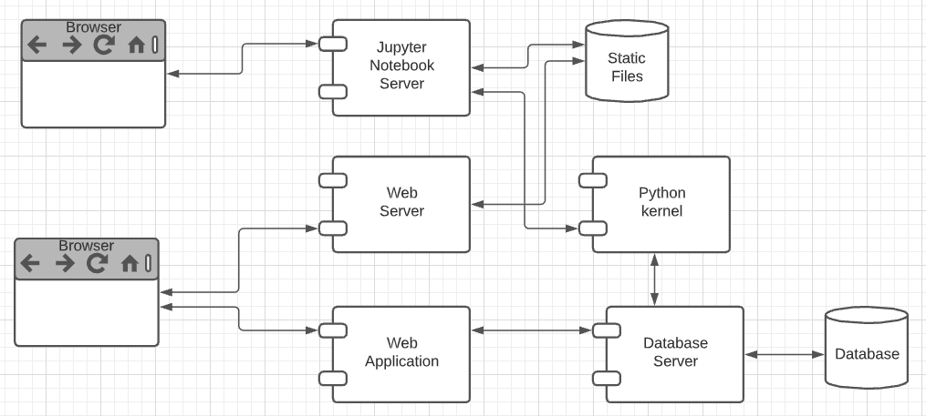
Harry Potter Character Information Application
Dataset:
https://www.kaggle.com/gulsahdemiryurek/harry-potter-dataset
Six “comma separated value (CSV)” files. We will start with Characters.csv.
Tasks: (Both tasks start with importing and engineering the data.)
Build an interactive web application for create-retrieve-update-delete entries. The application must enforce semantic integrity.
Build a Jupyter Notebook that does some interesting visualization and analysis.
Elements:
Content/applications in a browser.
Jupyter Notebook Server is both:
A web server
A (specialized) web application server.
Web server delivers HTML, images, ... to the browser.
Web application server executes an
Application server framework (Flask)
The Python code implementing the app.
The Jupyter Notebook Server runs code cells in a Python kernel.
I am mostly going to ignore the browser and content.

Slide 67
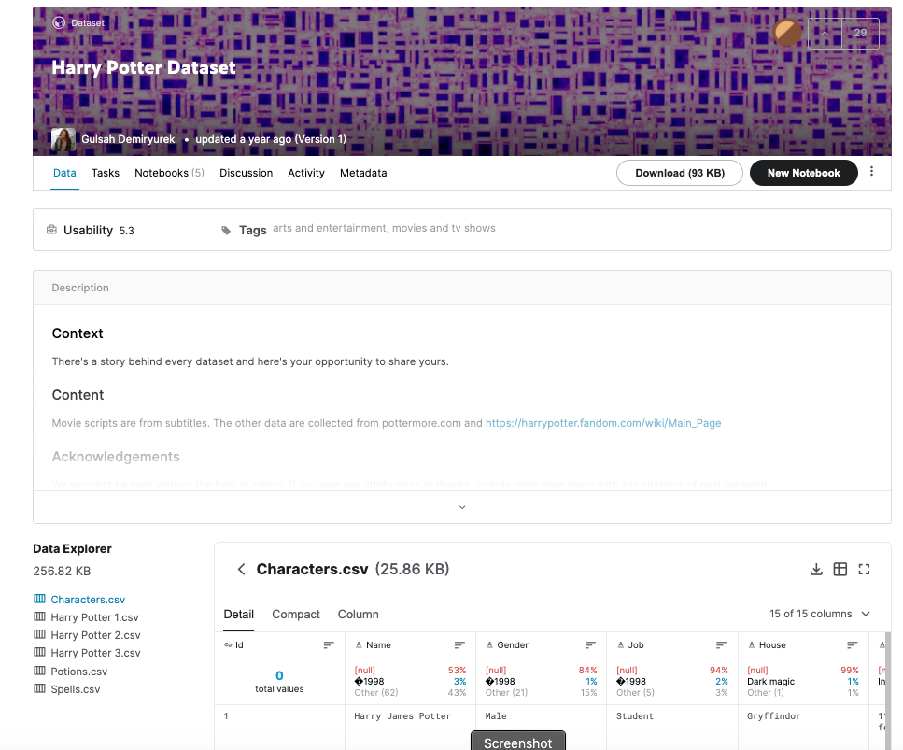
The Data – Characters.csv
15 columns:
Id
Name
Gender
Job
House
Wand
Patronus
Species
Blood status
Hair colour
Eye colour
Loyalty
Skills
Birth
Death
Downloaded the file.
The columns are separated by ‘;’
Despite being “Comma” Separated Values, other separators are common.
Loaded using DataGrip into MySQL
Connect
Create Schema
Use Schema
Use the data load tool.

Slide 68
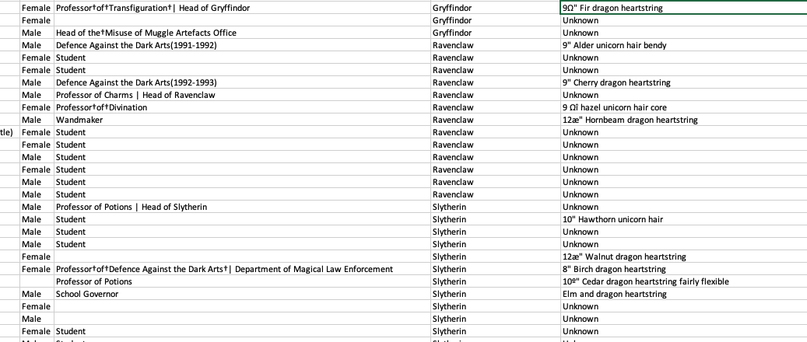
But First, Let’s Look at the Data
There are some weird characters, no pun intended.
9º" Chestnut dragon heartstring
Dumbledore's Army |Hogwarts School of Witchcraft and Wizardry
9Ω" Fir dragon heartstring
Professor†of†Transfiguration†| Head of Gryffindor
How did this happen?
What do we do?

Slide 69
Analysis (I)
Some of the issues are character encoding/set issues:
“In computing, data storage, and data transmission, character encoding is used to represent a repertoire of characters by some kind of encoding system that assigns a number to each character for digital representation.” (https://en.wikipedia.org/wiki/Character_encoding)
“A character set is a collection of characters that might be used by multiple languages.” (https://en.wikipedia.org/wiki/Character_encoding)
This will be a common issue when dealing with string data that you import to build your database.
This is especially true if the data comes from “data scraping”.
“Data scraping is a technique in which a computer program extracts data from human-readable output coming from another program.” (https://en.wikipedia.org/wiki/Data_scraping)
There are several types of scraping: screen scraping, web scraping, ... ...
That is what happened here. The data comes from web scraping a wiki page.

Slide 70
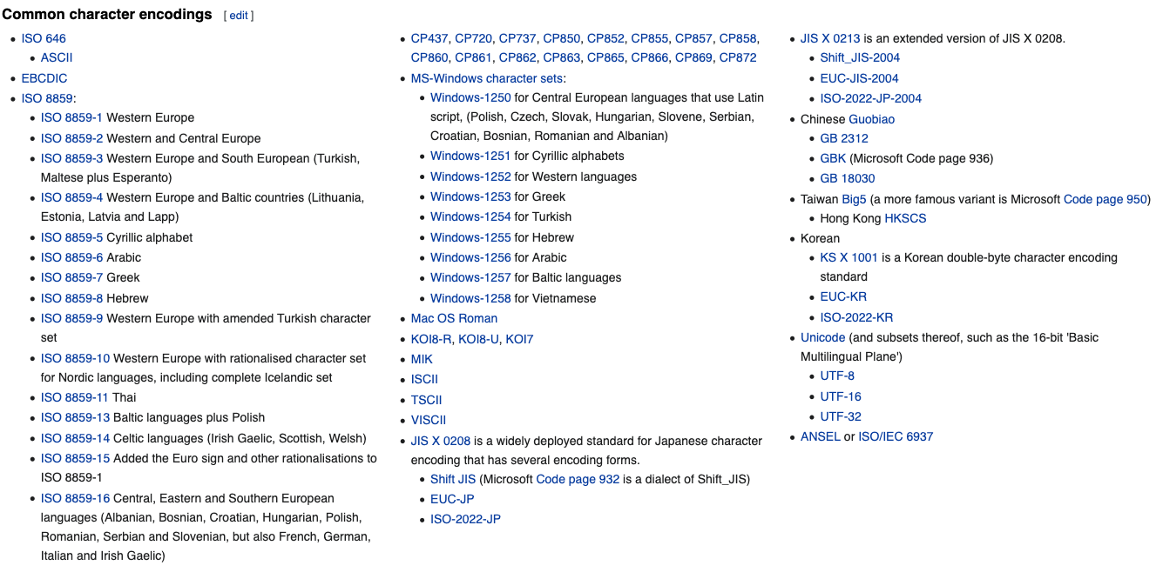
Character Encodings/Character Sets

Slide 71
Character Set Usage over Time
https://www.w3.org/International/questions/qa-who-uses-unicode

Slide 72
But, ... ...
Consider Job column entry: “Professor†of†Transfiguration†| Head of Gryffindor”
There are two odd characters: “†” and “|”
How should I correct/interpret the strings? My interpretation is:
Replace “†” with “ “.
The “|” means that the person has two jobs:
Professor of Transfiguration
Head of Gryffindor
The Job column is a multivalued attribute.
The character “|” indicates that a text string is one string containing multiple values for an attribute.
Can I always replace non-|, odd characters with “ “?
‘9Ω" Fir dragon heartstring’ and ‘9º" Chestnut dragon heartstring’ would wind up having an extra space. I want 9”, not 9 “.
The cleanup is getting complicated.

Slide 73
The Cleanup is Rule-Based
In this dataset, I can use a set of rules for data clean up:
Two characters separated by † maps to two characters separated by “ “ (space).
A number and “ separated by an odd character maps the the number and “
Strings of the form s1 | s2 | s3 maps to [s1, s2, s3]
etc.
Well, I could write a custom function for each rule,
But what happens when I find I need other rules.
It would be nice if there were some kind of tools that helps.
A regular expression is a sequence of characters that define a search pattern. Usually, such patterns are used by string-searching algorithms for "find" or "find and replace" operations on strings, or for input validation. It is a technique developed in theoretical computer science and formal language theory. (https://en.wikipedia.org/wiki/Regular_expression)

Slide 74
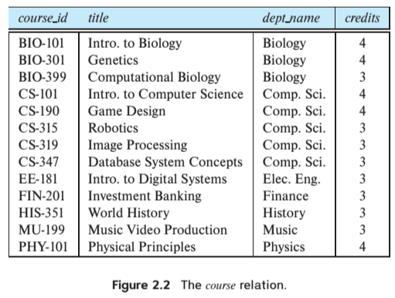
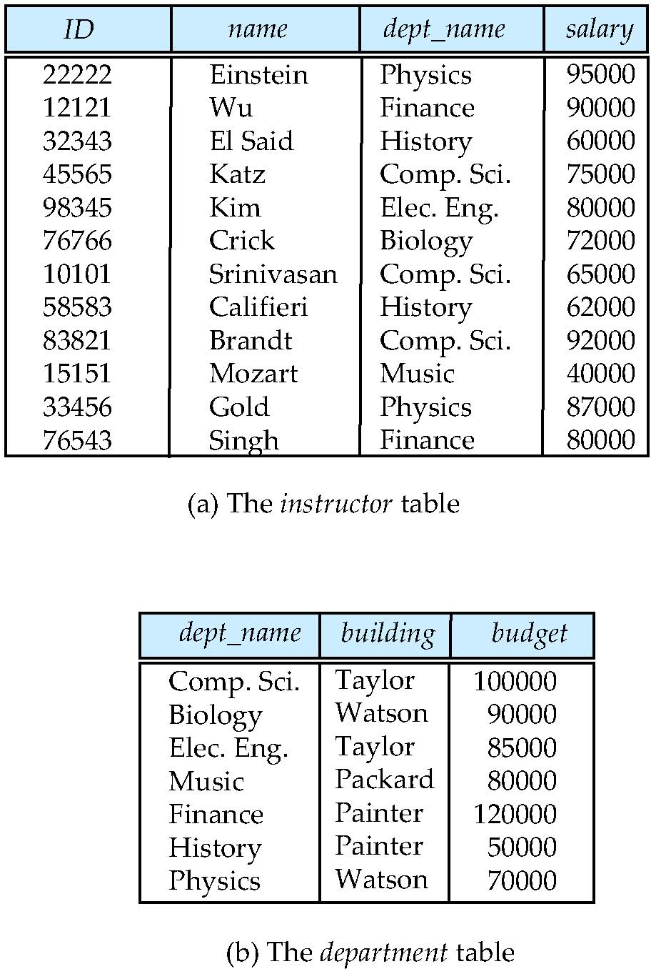
Multivalued Attributes
How about strings of the form s1 | s2 | s3 maps to [s1, s2, s3]. Is this cool?
All the data entity sets we have seen have had simple types/value attributes. Depends on the database model, e.g. relational, document, ...

Slide 75
Data Cleansing
https://blog.amplitude.com/big-data-cleanup
Database and data science classes love to teach the fun stuff queries, data modeling, machine learning, spooky math, algorithms, ... ...

Slide 76
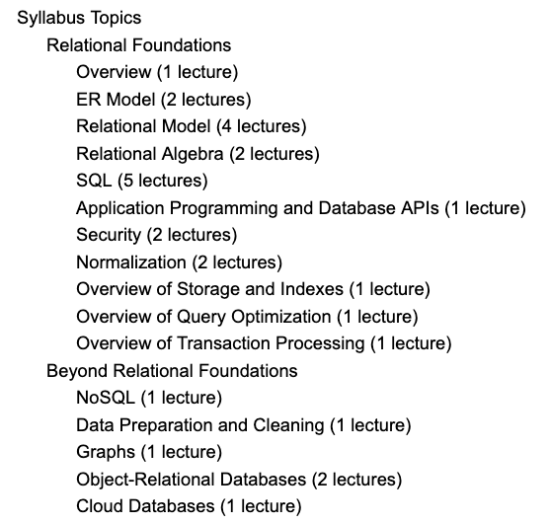
Data Cleansing
Recommended Syllabus
I place more emphasis on data cleansing and refactoring than other sections of W4111.

Slide 77
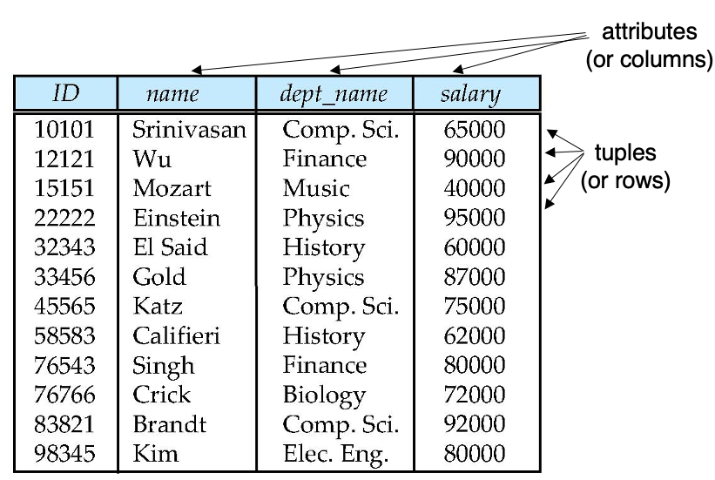
Next Steps in the Plan
Source Data
Relational Data
We are starting the semester with the relational datamodel/databases.
Before we get too far in our data janitor work, we should understand the relational model a little more.

Slide 78
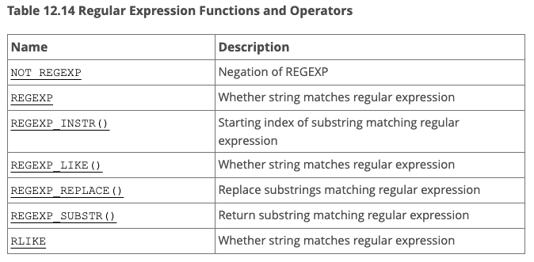
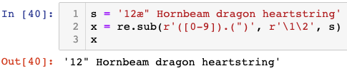
But, Before We Leave ... ...
What are these regular expressions whereout you speak?
Many environments come with regular expressions functions for searching and transforming strings.
Python: Lib/re.py (https://docs.python.org/3/library/re.html)
Java: java.util.regex (https://www.w3schools.com/java/java_regex.asp)
"SNOBOL ("StriNg Oriented and symBOlic Language") is a series of programming languages ... ... having patterns as a first-class data type.” (https://en.wikipedia.org/wiki/SNOBOL)
Most SQL databases have some from of regular expression library, but the libraries differ from product to product.
This was FYI.
Not a core part of W4111.
We will play with it a little.

Slide 79
Some More Set-Like Concepts
79 | COMS W4111_002_2021_1: Lecture 5: Advanced SQL and Projects © Donald F. Ferguson, 2021

Slide 80
Set Comparison – “some” Clause
Find names of instructors with salary greater than that of some (at least one) instructor in the Biology department.
Same query using > some clause
select distinct T.name
from instructor as T, instructor as S
where T.salary > S.salary and S.dept name = 'Biology';
select name
from instructor
where salary > some (select salary
from instructor
where dept name = 'Biology');

Slide 81
Definition of “some” Clause
F <comp> some r ⇔ ∃ t ∈ r such that (F <comp> t ) Where <comp> can be: <, ≤, >, =, ≠
0
(5 < some
5
) = true
(read: 5 < some tuple in the relation)
6
0
(5 < some
5
) = false
0
(5 = some
) = true
5
0
(5 ≠ some
5
) = true (since 0 ≠ 5)
(= some) ≡ in
However, (≠ some) ≡ not in

Slide 82
Set Comparison – “all” Clause
Find the names of all instructors whose salary is greater than the salary of all instructors in the Biology department.
select name
from instructor
where salary > all (select salary
from instructor
where dept name = 'Biology');

Slide 83
Definition of “all” Clause
F <comp> all r ⇔ ∀ t ∈ r (F <comp> t)
0
(5 < all
5
) = false
6
6
(5 < all
) = true
10
4
(5 = all
) = false
5
4
(5 ≠ all
) = true (since 5 ≠ 4 and 5 ≠ 6)
6
(≠ all) ≡ not in
However, (= all) ≡ in

Slide 84
Test for Empty Relations
The exists construct returns the value true if the argument subquery is nonempty.
exists r ⇔ r ≠ Ø
not exists r ⇔ r = Ø

Slide 85
Use of “exists” Clause
Yet another way of specifying the query “Find all courses taught in both the Fall 2017 semester and in the Spring 2018 semester”
select course_id from section as S where semester = 'Fall' and year = 2017 and exists (select * from section as T where semester = 'Spring' and year= 2018 and S.course_id = T.course_id);
Correlation name – variable S in the outer query
Correlated subquery – the inner query

Slide 86
Use of “not exists” Clause
Find all students who have taken all courses offered in the Biology department.
Note that X – Y = Ø ⇔ X ⊆ Y
Note: Cannot write this query using = all and its variants
select distinct S.ID, S.name
from student as S
where not exists ( (select course_id
from course
where dept_name = 'Biology')
except
(select T.course_id
from takes as T
where S.ID = T.ID));
First nested query lists all courses offered in Biology
Second nested query lists all courses a particular student took

Slide 87
Test for Absence of Duplicate Tuples
The unique construct tests whether a subquery has any duplicate tuples in its result.
The unique construct evaluates to “true” if a given subquery contains no duplicates .
Find all courses that were offered at most once in 2017
select T.course_id from course as T where unique ( select R.course_id from section as R where T.course_id= R.course_id and R.year = 2017);

Slide 88
Completing Subqueries
A subquery is a query inside a query.
Logically, the engine calls the subquery when evaluating every row in processing.
Correlation means properties from the outer row being evaluated are inputs to the inner query.
Subqueries:
Return tables if in the FROM clause.
Scalars in the SELECT clause.
Tables or scalars depending on the comparison operator in WHERE.
88 | COMS W4111_002_2021_1: Lecture 5: Advanced SQL and Projects © Donald F. Ferguson, 2021

Slide 89
Subqueries in the From Clause
SQL allows a subquery expression to be used in the from clause
Find the average instructors’ salaries of those departments where the average salary is greater than $42,000.”
select dept_name, avg_salary from ( select dept_name, avg (salary) as avg_salary from instructor group by dept_name) where avg_salary > 42000;
Note that we do not need to use the having clause
Another way to write above query
select dept_name, avg_salary from ( select dept_name, avg (salary) from instructor group by dept_name)
as dept_avg (dept_name, avg_salary)
where avg_salary > 42000;

Slide 90
Scalar Subquery
Scalar subquery is one which is used where a single value is expected
List all departments along with the number of instructors in each department
select dept_name, ( select count(*) from instructor where department.dept_name = instructor.dept_name) as num_instructors from department;
Runtime error if subquery returns more than one result tuple

Slide 91
Switch to Notebook
Switch to Notebook

Slide 92
Backup
Backup

